Slide 1
Open Source
Labor Economics
Prof. Dr. Dirk Riehle
Friedrich-Alexander University Erlangen-Nürnberg
FOSS C07
Licensed under CC BY 4.0 International
Notes:
It is Friedrich-Alexander University Erlangen-Nürnberg – FAU, in short.
Corporate identity wants us to say “Friedrich-Alexander University”.

Slide 2
Video on Open Source Career
Linus Torvalds
Why you should choose a career
in Linux and open source

Slide 3
Video Lesson
Traditional motivations for participating in open source
  Do something good (altruism)
  Learn something
  Have fun

Slide 4
Traditional Developer Careers
Sales and Marketing
Product Management
Engineering
Chief Product Officer
...
...
...
Jr. Sales Associate
Jr. Product Manager
Jr. Engineer
Business
Student
Engineering
Student

Slide 5
Hiring Developers (Erich Gamma)
“[…] when I received the first job application with a link to a code contribution to an open source project, I immediately followed the link, reviewed the code, invited the candidate for an interview round, and eventually made an offer. A link to a code contribution to an Open Source project is a great differentiator in a job application, in particular when you have to select among a large number of applications.”
Erich Gamma [R15a]

Slide 6
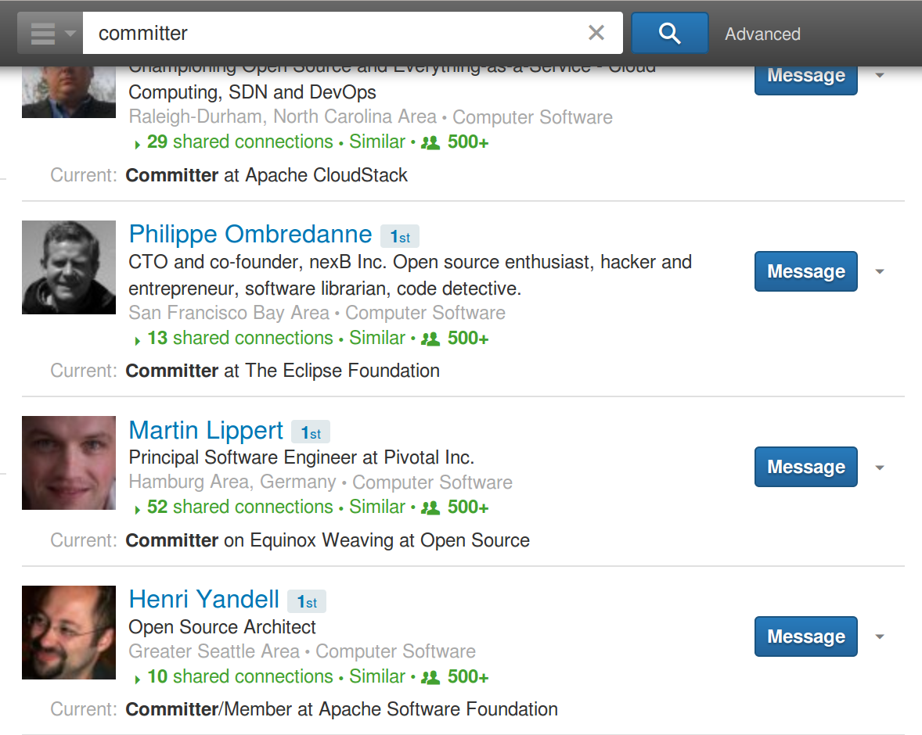
Committers in Your Network

Slide 7
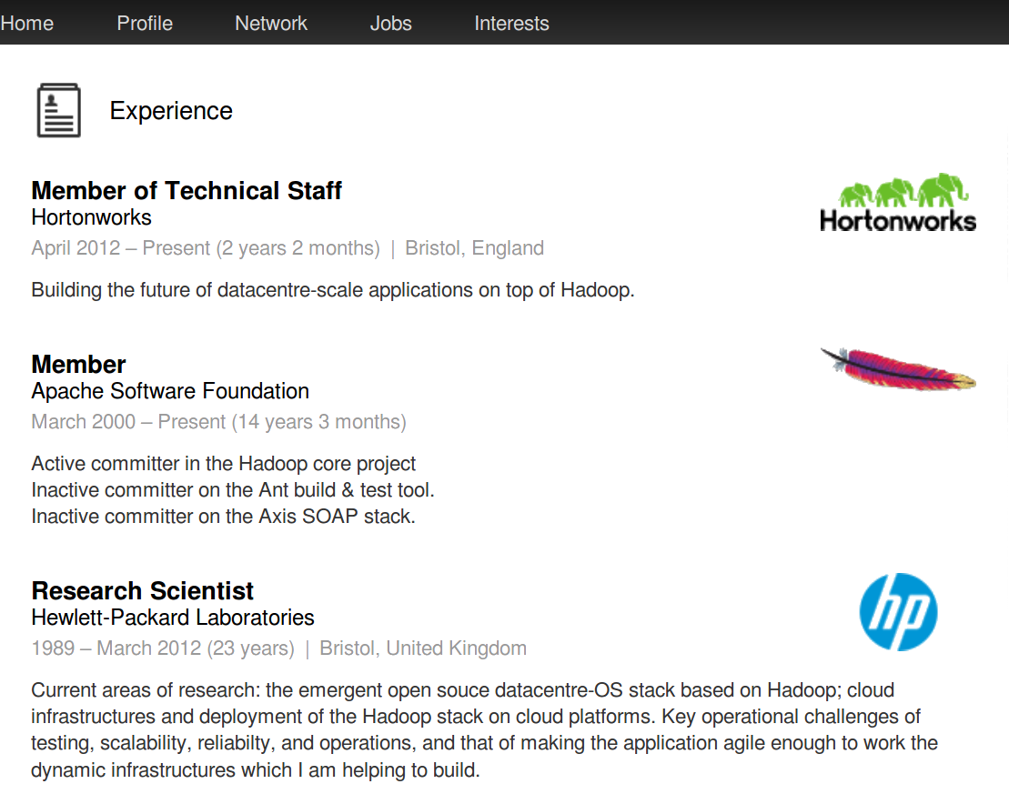
Example (LinkedIn) Resume

Slide 8
Labor Economics of Open Source [1]
Open source career stages
Value creation, signaling
Value appropriation
[1] This lecture is loosely based on my paper “How Open Source is Changing the Software Developer’s Career” available at http://wp.me/Pe4V6-WV

Slide 9
Open Source Developer Career Path
Committer
Foundation
Member
explicit promotion
explicit promotion
Contributor
PMC Leader
implicit promotion
explicit promotion
User
PMC Member
from committer

Slide 10
Hiring Developers (Chris DiBona)
“Open source software is strategic to Google, and naturally we hire a great number of open source developers. Someone who demonstrates their ability by contributing to open source projects shows that they are able to code in the real world in ways other developers can not readily match. It’s the ultimate referral.”
Chris DiBona [R15a]

Slide 11
Value and Signals
Verifiable technical skills
Peer-confirmed competencies
Position of power and influence

Slide 12
I. Verifiable Technical Skills
Technical skills in general
Technical skills for a project

Slide 13
The Signaling Hypothesis [LT02]
Open source is public work, more precisely measurable, and less captive that traditional work
Developers compensate opportunity costs by “signaling” marketable skills to future employers
At time of publication of [LT02] (2002), authors said volunteer developers were dominant

Slide 14
Hiring Developers (Marten Mickos)
“From a software vendor’s perspective, open source work on a developer’s resume is a definitive plus. [...] If the developer even contributed to our [open source] products, it increases their chance of being successful at our company: Ramp-up time will be shorter and we know they are likely to be a better fit than an unknown developer. All of this leads us to prefer open source developers when hiring.”
Marten Mickos [R15a]

Slide 15
II. Peer-Confirmed Competencies
Peer-confirmed technical skills
Peer-confirmed social competencies
Peer-confirmed leadership competencies

Slide 16
Value of Peer Confirmation
Peer confirmation
  Successful open source contribution implies technical skills
  Skills are peer-confirmed and publicly documented
Economic value
  Confirmed technical skills reduce hiring risk
  Lower hiring risk reduces uncertainty discount in salary negotiations

Slide 17
VC Investments (Rachel Chalmers)
“When we look at a start-up, we look at the GitHub repositories, we look at Ohloh.net. We drill down to the level of individual developers. It informs our investment decision. That fact alone gives open source software developers significant leverage when negotiating their position, salary, and benefits with startups.”
Rachel Chalmers [R15a]

Slide 18
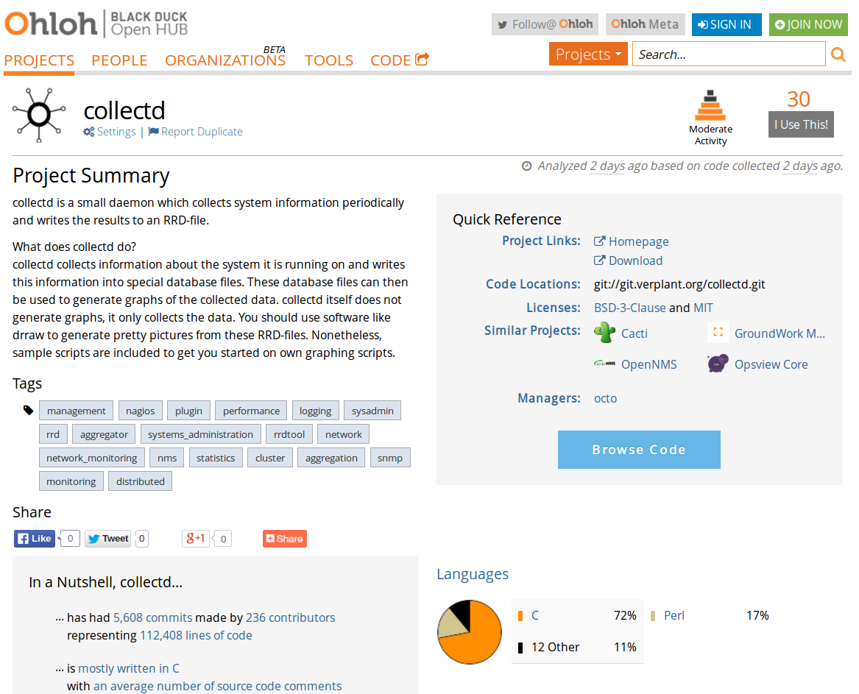

Slide 19
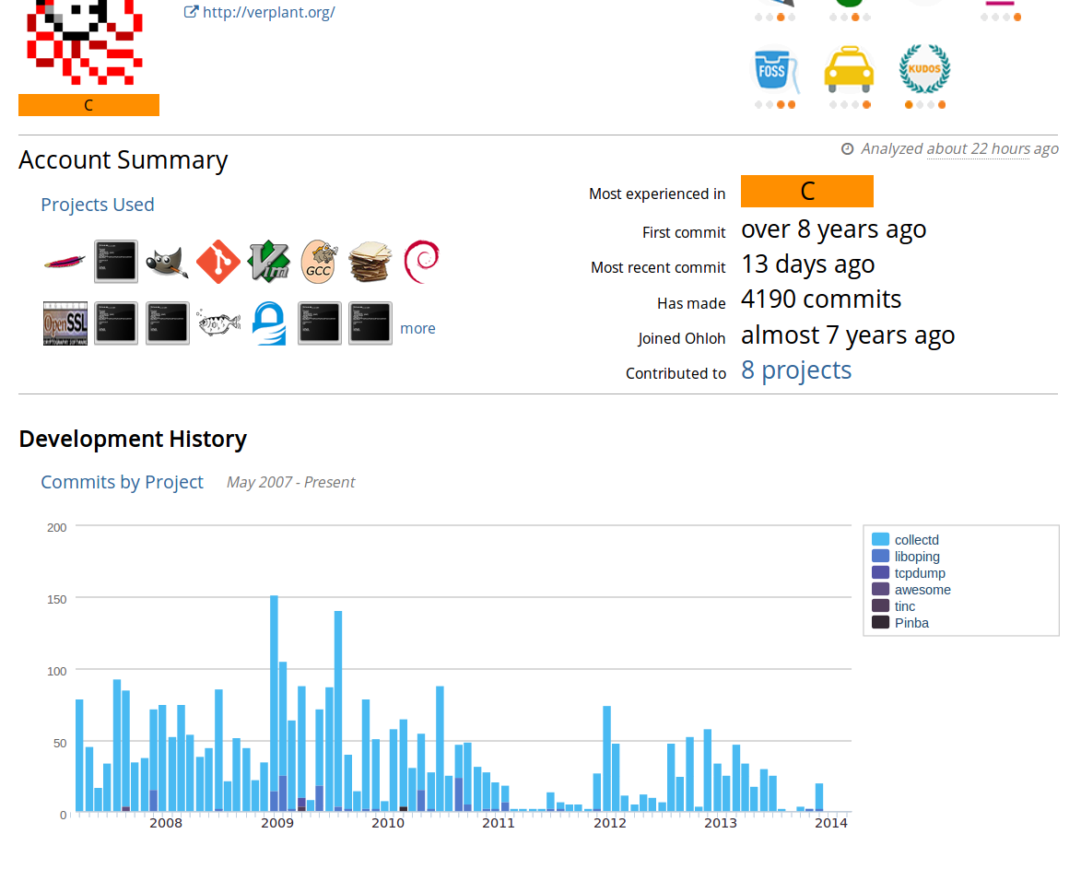

Slide 20
Company Culture (Robert O’Callahan)
“Open source contributors tend to believe in and practice the values that characterize successful open source projects, such as community, meritocracy and transparent government. Hiring those people strengthens those values within your corporate culture.”
Robert O’Callahan [R15a]

Slide 21
III. Position of Power and Influence
Position of power and influence in project
Visibility to community and beyond

Slide 22
Value of Contributor Position
The “Apache Committer study” [H+02]
  Open source contributions in themselves don't correlate with higher wages
  Higher status within merit-based Apache Software Foundation project does
  Committers showed 29% higher salary after controlling for all variables
  Study suggests that status is a proxy for otherwise unobservable skills
The “c’t Salary Survey” [B+10]
  61% of respondents believe open source activity benefits their career
  Study shows no wage premium for voluntary open source contributions

Slide 23
Value of Committer Position
“[...] the wage of contributors with rank committer or above is on average about 29% higher than that of [other] developers after controlling for education, programming experience, work experience, job switch, and firm characteristics.” [H+02]

Slide 24
Value of Position (Justin Erenkrantz)
“At the ASF, members of the Project Management Committee are recruited from the project contributors. As the recognized stewards of the project, all PMC members (including the appointed chair) wield significant power over the project through the power of the veto.”
Justin Erenkrantz [R15a]

Slide 25
Value of Position to Employer
More predictable project
Faster-better-cheaper development
More influence on project
Higher assumed competence
More and easier sales
More goodwill with community
More effective recruiting
More attractive employer

Slide 26
Faster-Better-Cheaper Development
More predictable project
  Because inside view allows for faster recognition of what's likely to happen
    A committer has a deeper understand and insight into the project
    A committer knows who to talk to and which knobs to turn
  A more predictable project leads to
    Problems get identified and fixed faster
More influence on project
  In case of leadership position
  More influence leads to
    Forming future strategic direction of project
    Better strategic alignment of company products
      Being aligned earlier, better, removes uncertainty and waste, lowers costs
      Being aligned sets up employer to utilize new opportunities faster than others

Slide 27
More and Easier Sales
Higher assumed competence
  Because of project engagement
  Higher assumed competence leads to
    Customers believing that company is particularly capable
More influence on project
  Because of leadership position
  More influence on project leads to
    Customers believing that less things might go wrong
More goodwill with community
  Because of project engagement
  More goodwill with community leads to
    Higher visibility make leader a go-to-person wrt project
    Higher likelihood for talks, panels, articles follows

Slide 28
More Effective Recruiting
More attractive employer
  Because of being a place with interesting work, interesting people
  Being a more attractive employer leads to more effective recruiting
More goodwill with community
  Because of contributions to project
  Having more goodwill with community leads to
    Being reputed, being attractive, more effective recruiting

Slide 29
Relevance of Value to Employer
Business Goal
Reduce
Development Costs
Maximize
Customer Exposure
Minimize
Competition
Social leadership²
Domain ownership²
Copyright control²
Trademark control²
Development process²
Proprietary
Open Source
Component Type
Social leadership^{1, 2}
Social leadership^{2, 3}
Domain ownership³
Strategic positioning^{2, 3}
Trademark control³
Development process^{2, 3}
Strategic positioning^{2, 3}
Community
Open Source
¹ Closed source firm
² Single-vendor open source firm
³ Open source distributor

Slide 30
Value of Position (Kai-Uwe Mätzel)
“My contributions to the Eclipse project (2000-2007) resulted in a high visibility in the Eclipse affine developer community. Pretty much every offer I received during these years from potential employers explicitly referred to my reputation in the Eclipse project.”
Kai-Uwe Mätzel [R15a]

Slide 31
Summary of Value to Developer
Higher salary
Higher job security
Richer job experience

Slide 32
The Software Developer Labor Market
A typical asymmetric market (less employers than employees)
  Traditionally, work remains hidden (cf. reduced hiring risk)
Contributor status does not provide a sustainable advantage
  Everyone who is smart enough can contribute and gain recognition
  No barriers to entry, there is always one more feature to implement
  No barriers, because open source is freely available to everyone
Committer status does provide sustainable positional advantage
  Status has economic value, is not achieved or handed out easily
  Mature projects are largely closed to new committers
  Once achieved, committer status is not taken away easily

Slide 33
The Long-Run Perspective
Regular developers
  Employed to develop proprietary code
  Know and use open source, may or may not contribute
  Lower barriers to labor market entry push down salaries
Open source committers
  Employed to work on commercially relevant open source
  Committers’ economic value is with open source project
  Committers to behave more like free agents than employees
  Scarcity of committer status may lead to superior salaries
Developer labor market to become a two-class society?

Slide 34
Skills Profile of a Committer
Need technical competence on project
  Typically programming skills, but real projects need more
  Configuration, administration, documentation, website, ...
  An understanding of the processes of how systems are built
Social skills are equally important if not more so
  Need communication and collaboration skills for team work
  Need good reading and writing skills (email communication)
  Leadership skills are always rare and in demand
  Need to understand peer behavior, subculture
All things being equal, social skills are more important

Slide 35
How to Become a Committer?
Achieving committer status is a communal process
  Users work their way up from user to committer status
  This builds reputation and reduces risk of wrong decision
  Eventually, contributor is put up for committer status
  Decision is typically made by vote of existing committers
There is good and there is bad timing
  A growing project needs more people, will give more responsibility early on
  A mature project with slowing growth rarely needs more committers
  Try to get in early when every helping hand is needed
The prospective committer’s dilemma: Which project to bet on?

Slide 36
Conclusions
A new career path has emerged
  It is related but different to prior paths
Hypothesized effects on careers
  In the short-run, open source developers may improve their wages
  In the long-run, some form of peer confirmation becomes a must
Effects on developer labor market
  Reduced barriers to market entry make life harder for developers
  The way out is to become a committer, but that is a scarce status
  Committers to relevant open source projects can benefit significantly

Slide 37
Review / Summary of Session
Developer engagement
  Career stages
  Value and signals
  Value appropriation
Value to company
  Faster-better-cheaper development
  More and easier sales
  More effective recruiting
Value to developer
  Higher salary
  Higher job security
  Richer job experience

Slide 38
Thank you! Questions?
dirk.riehle@fau.de – http://osr.cs.fau.de
dirk@riehle.org – http://dirkriehle.com – @dirkriehle
DR

Slide 39
Credits and License
Original version
  © 2012-2019 Dirk Riehle, some rights reserved
  Licensed under Creative Commons Attribution 4.0 International License
Contributions
  ...

